Slide 1
LAMBTON COLLEGE
Project
Presentation on
“ PARKING LOTS ”
PRESENTED BY
Jat Pintu

Slide 2
Contents
Introduction
Existing Research
Case Studies
Conclusion

Slide 3
Introduction
A parking lot or car park , also known as a car lot, is a cleared area that is intended for parking vehicles. Usually, the term refers to a dedicated area that has been provided with a durable or semi-durable surface. In most countries where cars are the dominant mode of transportation, parking lots are a feature of every city and suburban area. Shopping malls, sports stadiums and similar venues often feature parking lots of immense area.

Slide 4
Existing Reasearch
Widespread popularity of the automobile leads to increasingly serious parking problem. Raising the utilization ratio of the existing parking lots is one of the solutions for this problem. A method combining automatic planning and manual adjustment is proposed in this paper for planning parking space in the parking lots. It divides the lot into rectangular regions as appropriate as possible. Every one of the regions is planed automatically aiming to obtain the optimal plan. We remove the parking space which is occupied by the obstacles or blocking the passages through manual adjustment, and the final distribution of the parking space will be produced. The corresponding optimal mathematics model is built and the feasibility and effectiveness of our method are verified through a case studying.

Slide 5
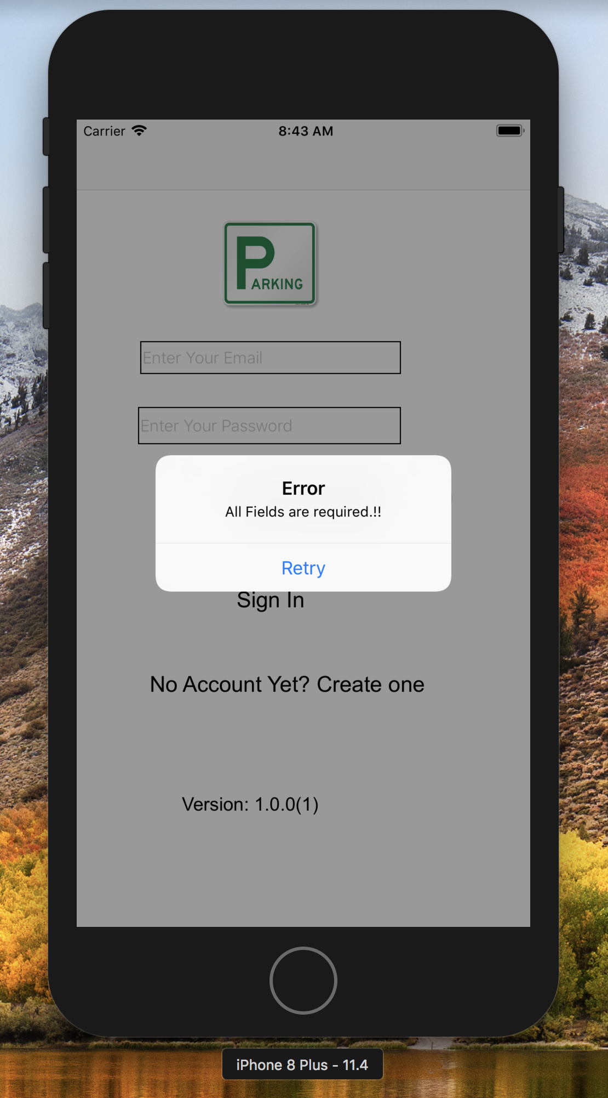
New User Registration

Slide 6
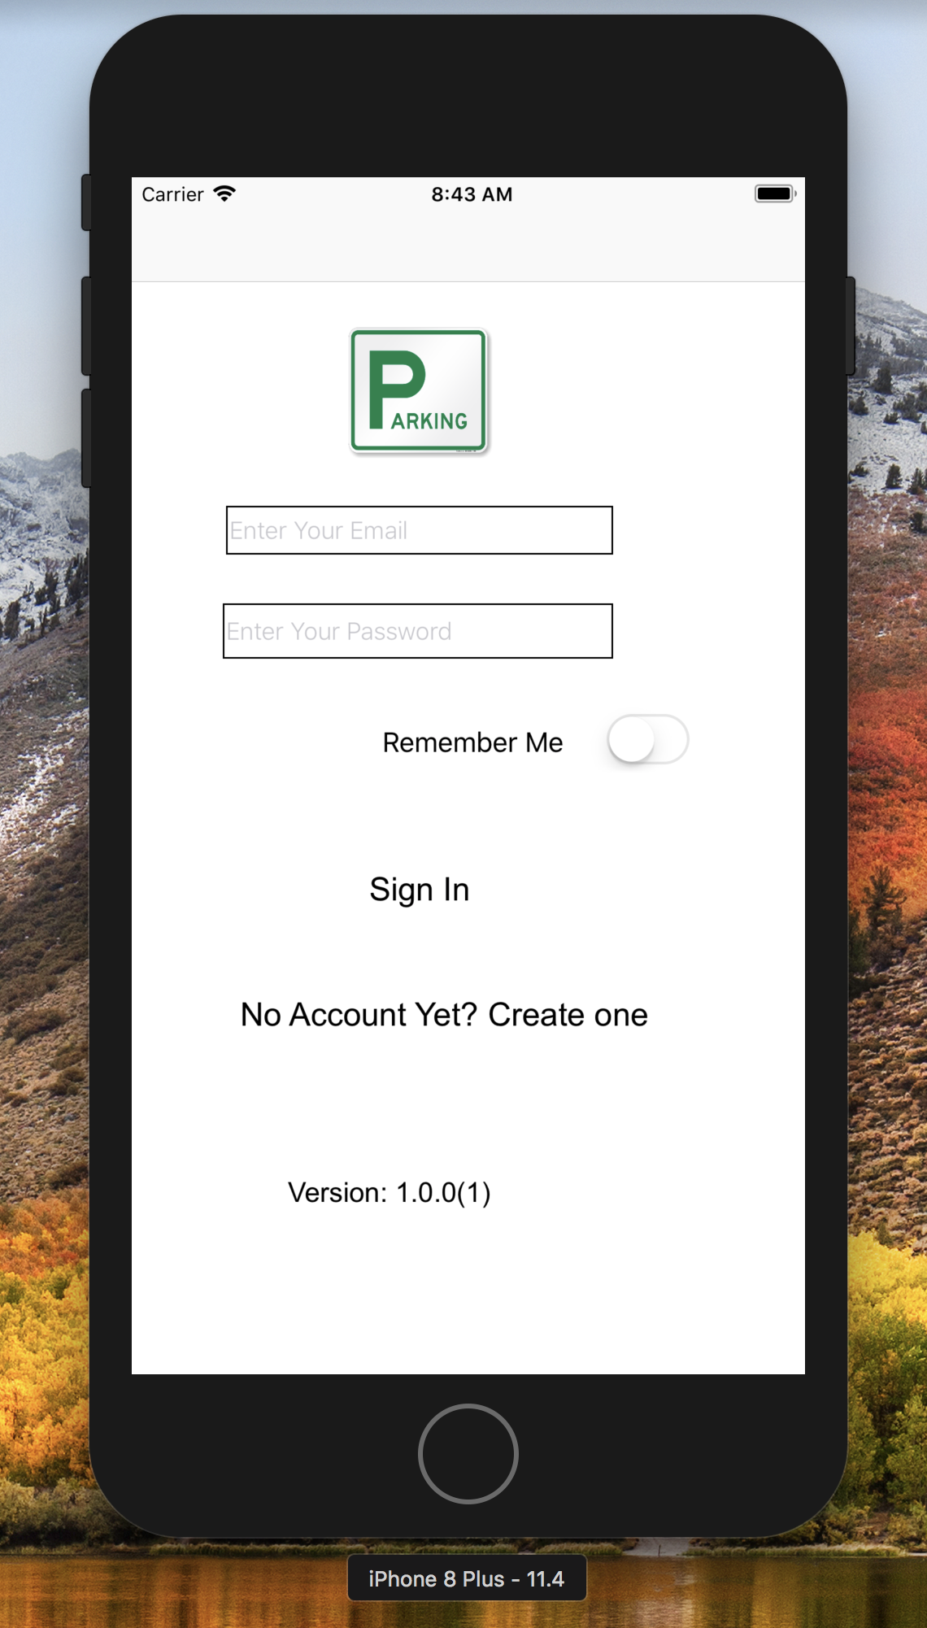

Slide 7
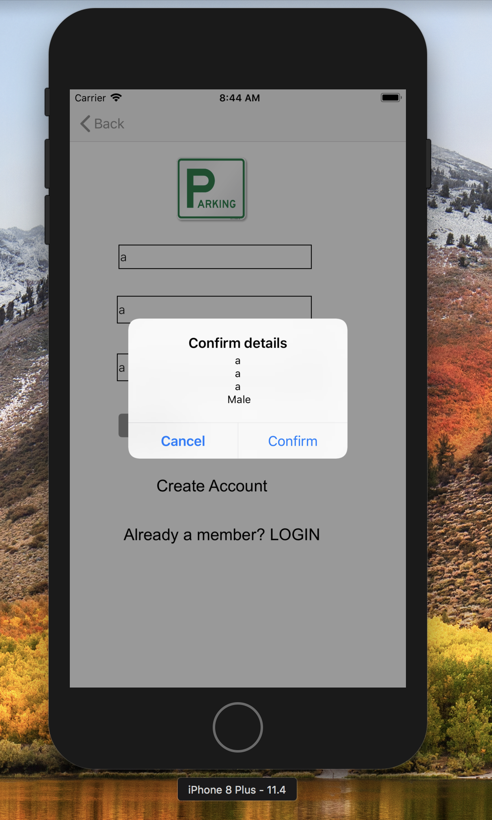

Slide 8
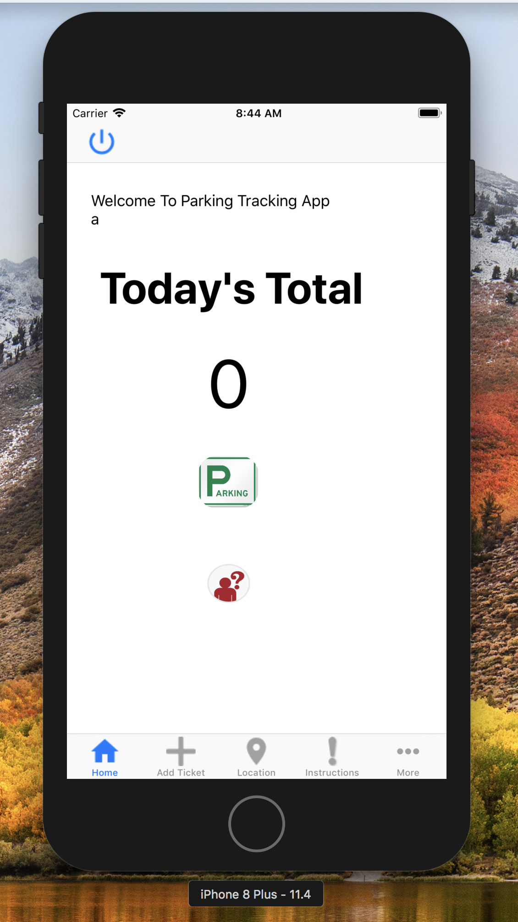
Home Screen

Slide 9
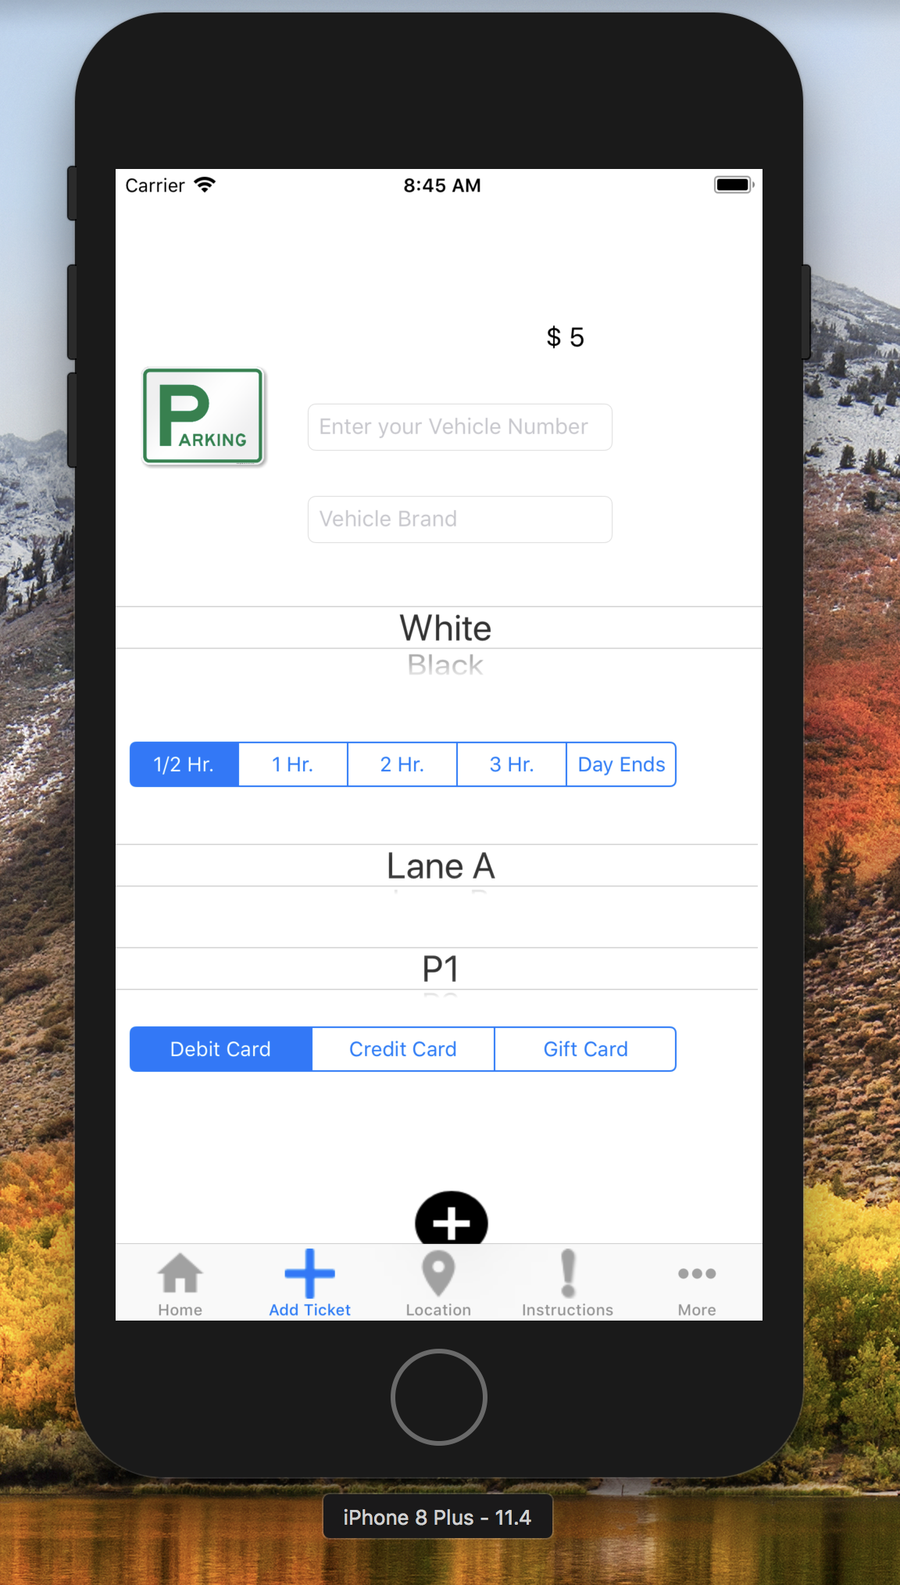
Here The Ticket Will Be Generated

Slide 10
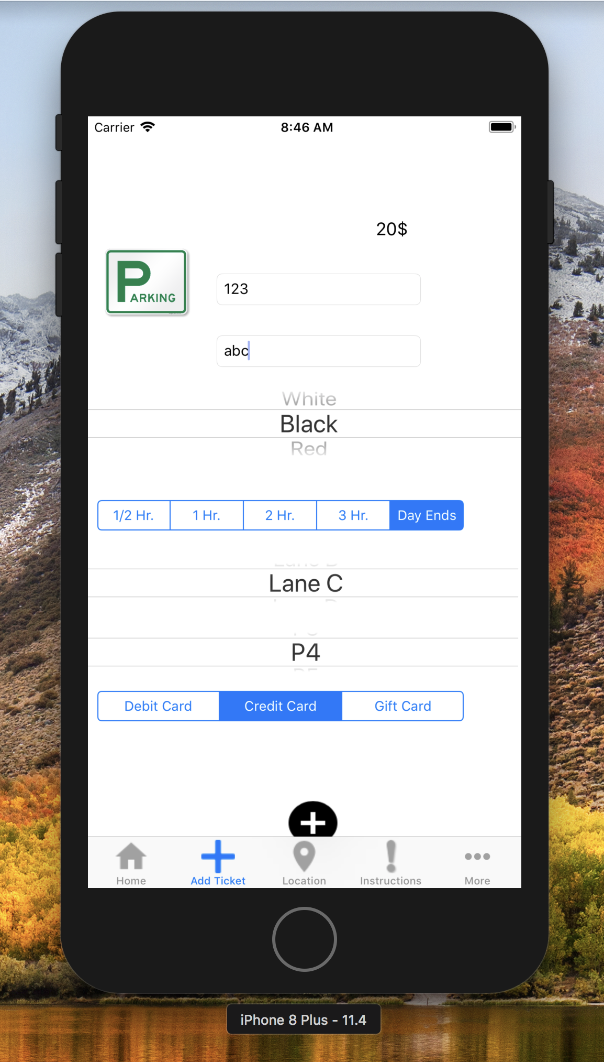
The Amount Will Be Upadated according to the duration

Slide 11
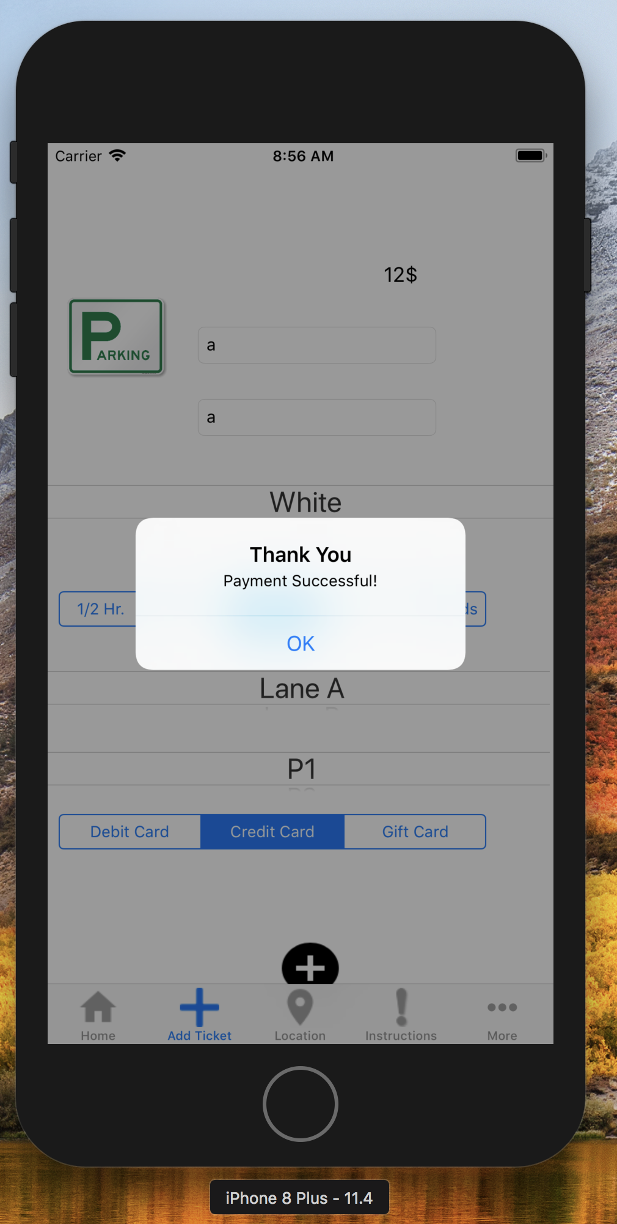
Successful Creation Of the Ticket

Slide 12
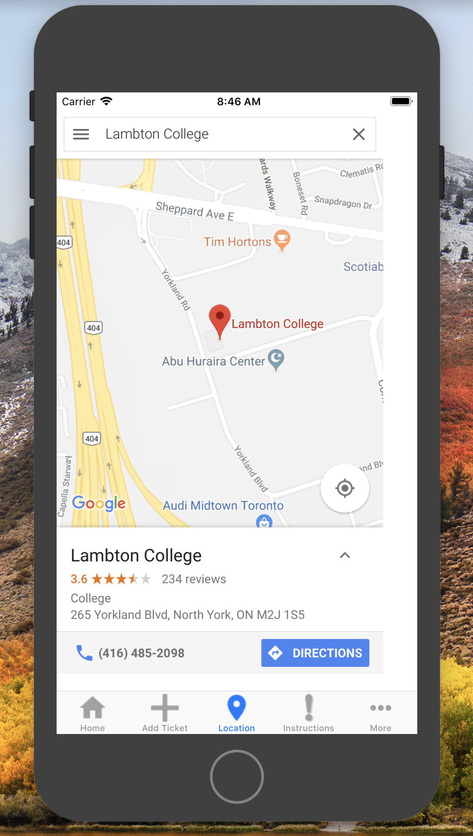
We have implemented inbuilt Real Time Location MAP

Slide 13
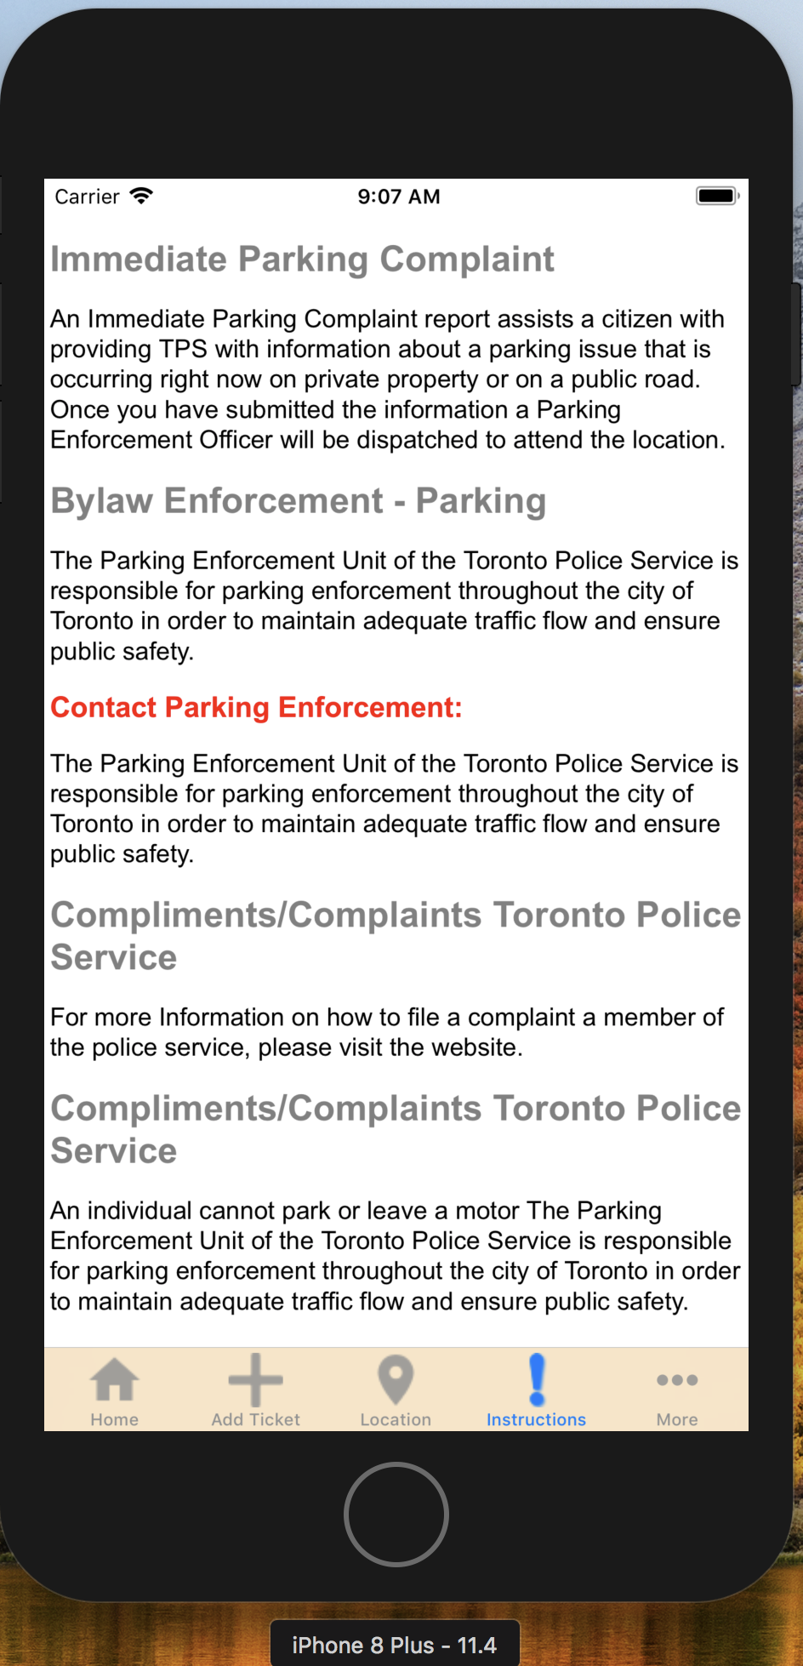
Information About Legal Parking

Slide 14
Any Queries???

Slide 15
THANK YOU…

